Slide 1
Feature Selection

Slide 2
Feature Selection
Feature selection is primarily focused on removing non-informative or redundant predictors from the model.
Applied Predictive Modeling, 2013.

Slide 3
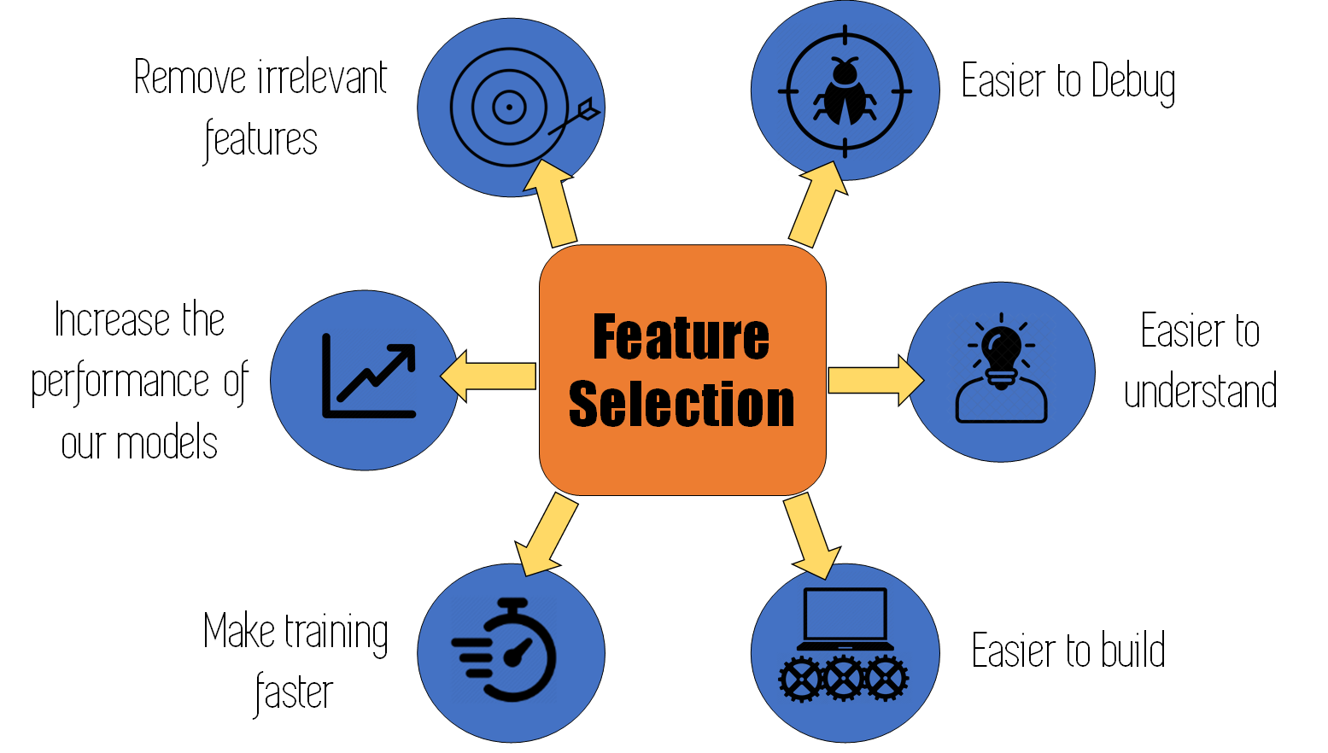
https://www.omnisci.com/technical-glossary/feature-selection

Slide 4
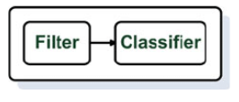
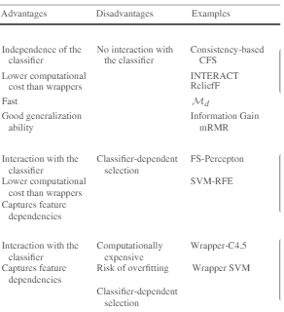
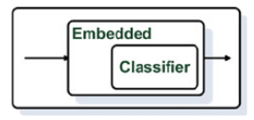
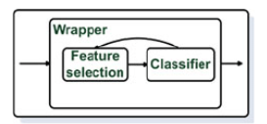
Filter Method
Embeded Method
Wrapper Method
Bolón-Canedo, Verónica & Sánchez-Maroño, Noelia & Alonso-Betanzos, Amparo. (2012). A review of feature selection methods on synthetic data. Knowledge and Information Systems. 34. 10.1007/s10115-012-0487-8.

Slide 5
Filter Method
Filter methods select features based on statistics rather than feature selection cross-validation performance
https://www.omnisci.com/technical-glossary/feature-selection

Slide 6
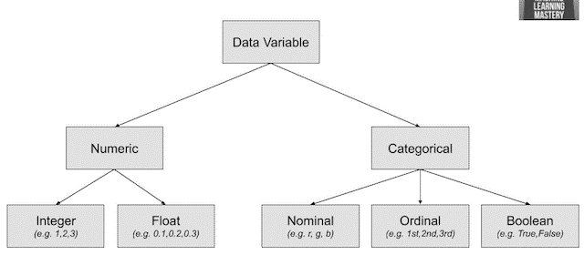

https://machinelearningmastery.com/feature-selection-with-real-and-categorical-data/

Slide 7
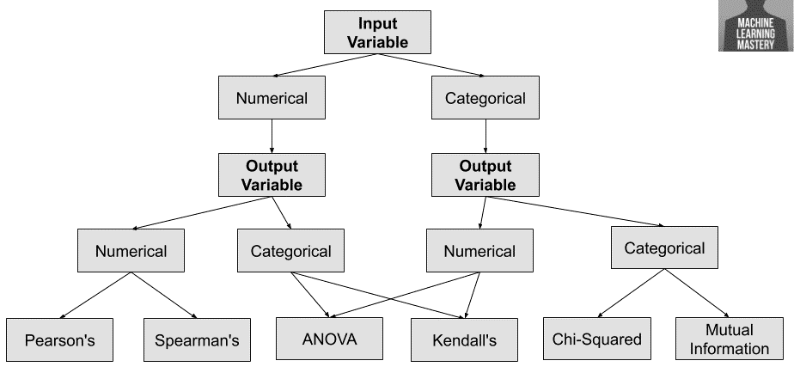
Feature Selection Filter Method
(Linear)
(Nonlinear)
(Linear)
(Nonlinear)
(Mixed Data)
https://machinelearningmastery.com/feature-selection-with-real-and-categorical-data/

Slide 8
Wrapper Method
Wrapper feature selection methods consider the selection of a set of features as a search problem, whereby their quality is assessed with the preparation, evaluation, and comparison of a combination of features to other combinations of features
https://www.omnisci.com/technical-glossary/feature-selection

Slide 9
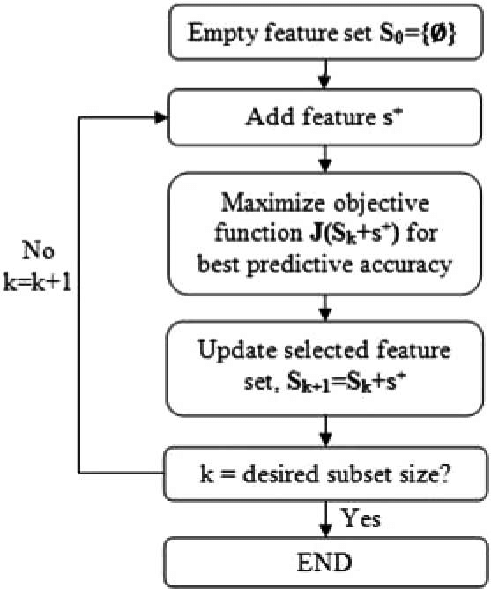
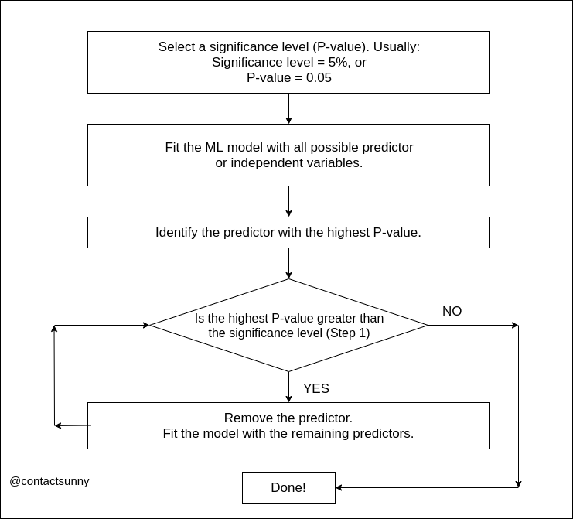
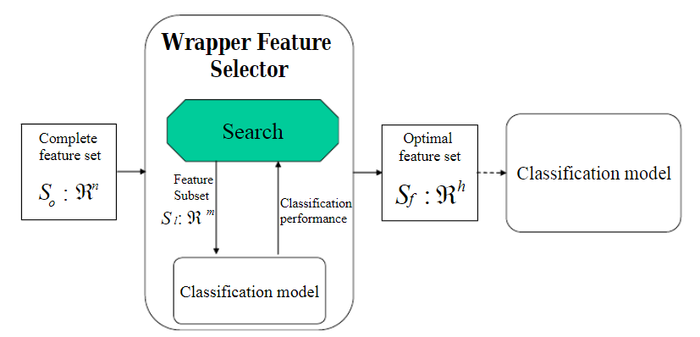
Forward
Method
Backward
Method
Yang, Hui. (2011). Multiscale Recurrence Quantification Analysis of Spatial Cardiac Vectorcardiogram Signals. IEEE transactions on bio-medical engineering. 58. 339-47. 10.1109/TBME.2010.2063704.
Baraldi, Piero & Zio, Enrico & Roverso, Davide. (2007). Feature Selection for Nuclear Transient Diagnostics. 10.13140/RG.2.1.2010.8321.

Slide 10
Embeded Method
Embedded feature selection methods integrate the feature selection machine learning algorithm as part of the learning algorithm, in which classification and feature selection are performed simultaneously.

Slide 11
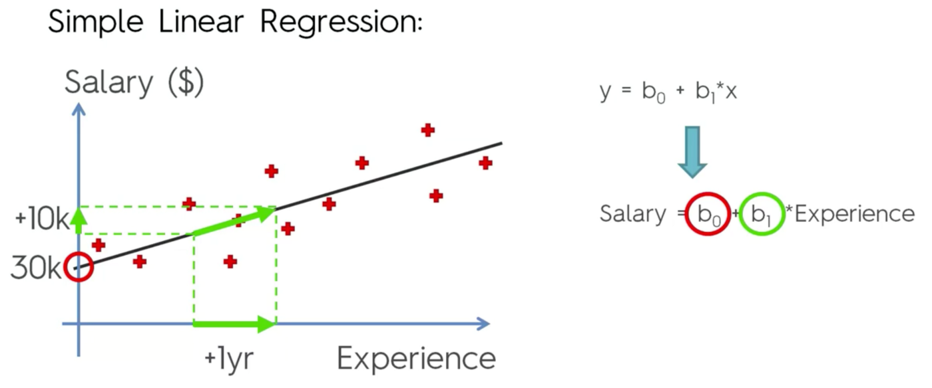
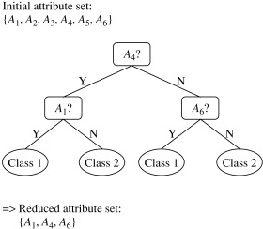
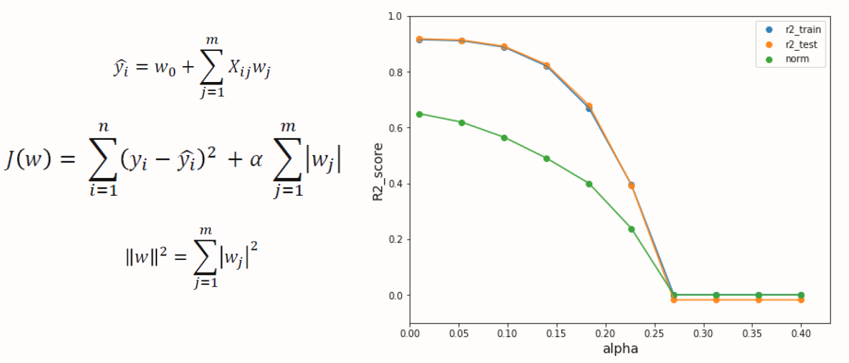
Coefficient
Tree Based
Lasso
https://medium.com/analytics-vidhya/feature-selection-embedded-methods-a7940036973f#3998

Slide 12
Thank You

